Slide 1


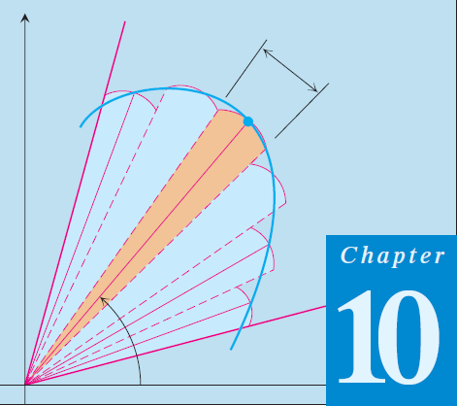
01
Thomas Calculus 11th
02
Polar Coordinates Aplications
Samuel Lukas

Slide 2
Agenda
Area in Polar Coordinates
Length of a Polar Curve
Area of a Surface of Revolution

Slide 3
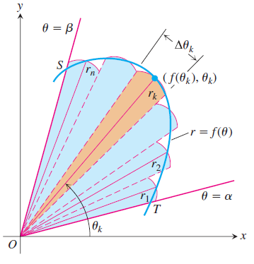


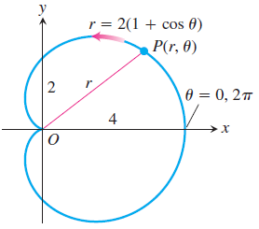
Areas in Polar Coordinates

Slide 4
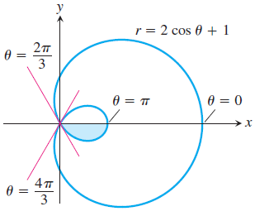






Example 1

Slide 5
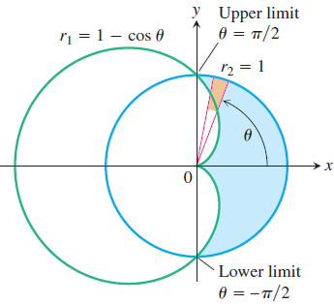






Example 2

Slide 6


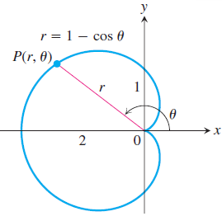




Length of a Polar Curve

Slide 7
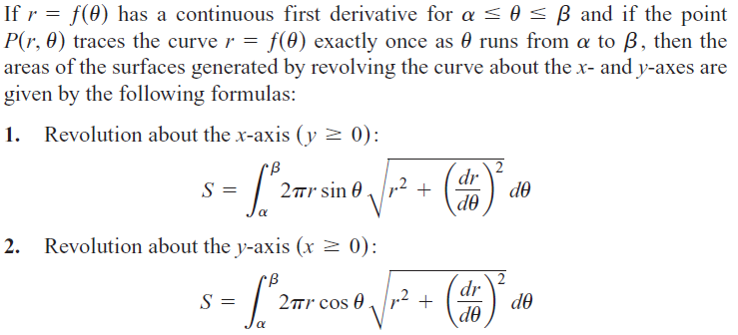
Area of a Surface of Revolution

Slide 8

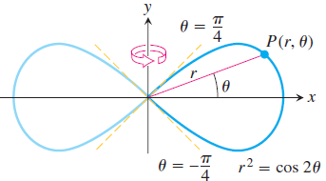

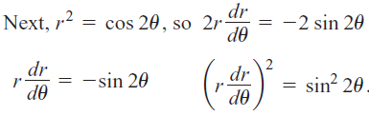
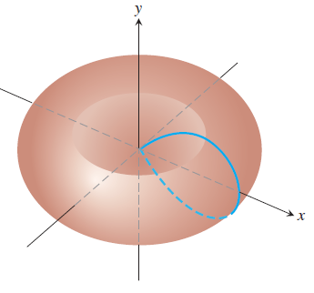



Example 5

Slide 9
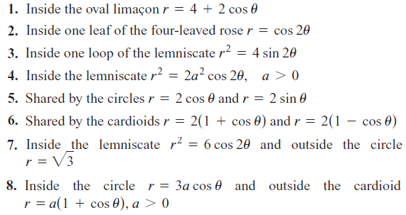
Exercises 1
Find the areas of the regions

Slide 10
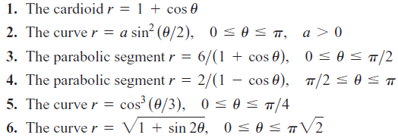

Exercises 2
Find the lengths of the curves
Find the areas of the surfaces generated by revolving the curves about the indicated axes.

